Slide 1



ADDING CPU
-
Team:
L Uma (N190376)
M John David (N190753)

Slide 2

Contents
Introduction .
Components and its description
Instruction format
Datapath Description
Architectural Design Of Adding CPU
Datapath Verilog Code
Control Path Design
Controller Verilog Code
Testbench Outline
Schematic and Results
2

Slide 3
INTRODUCTION
4
we use is a simple adding machine, which we refer to
as AddingCPU. It must be mentioned, that we are using this example
to demonstrate our design and test methodologies
Our Adding CPU reads Load, Add, Store, and Jump instructions
from its memory, and depending on the instruction it reads, loads data performs addition, stores data into memory, or jumps to another memory location
or jumps to another memory location
.
The CPU has a 8-bit data bus and a 6-bit address bus.
The processor has 8 instructions.
Control signals, reset, rd_mem, and wr_mem
are used for resetting, memory read, and memory write operations.

Slide 4
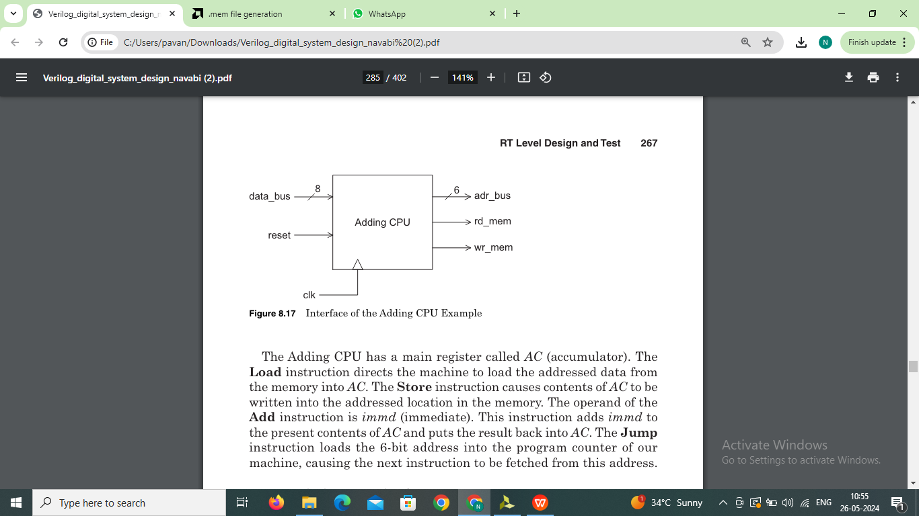
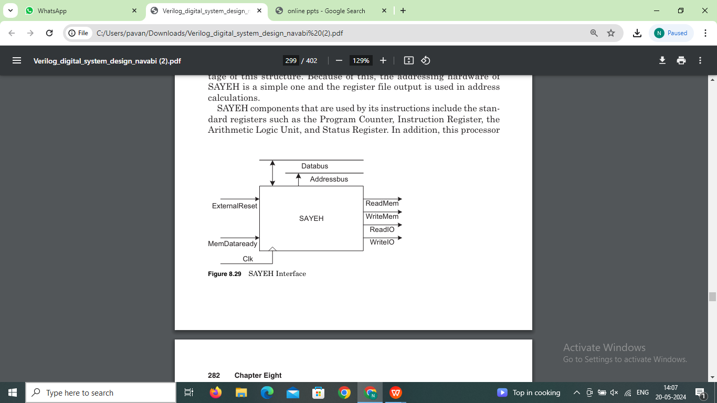
Adding CPU Interface Signals are as Follows:
4

Slide 5

CPU Components
Adding CPU components that are used by its instructions includes:
Accumulator Register
Program Counter
Instruction Register
Arithmetic Logic Unit

Slide 6
Description
CPU components and a brief description of each are shown below:
PC. Program Counter, 8 bits
The program counter(PC) is a counter with parallel load,increment and
clear capabilities, this component has three control signals to control
its functionality.
AC. Accumulator, 8bits
IR. Instruction Register,8bits
Accumulator (AC) and instruction register (IR) are simple registers
with load enable control inputs. These inputs are driven by control
signals coming from the controller through datapath ports.
ALU. Arthemetic logic unit
The ALU is a combinational logic with pass and add control inputs. If pass is 1, the a input goes on the output, and if add is 1, the ALU output becomes the sum of a and b.

Slide 7
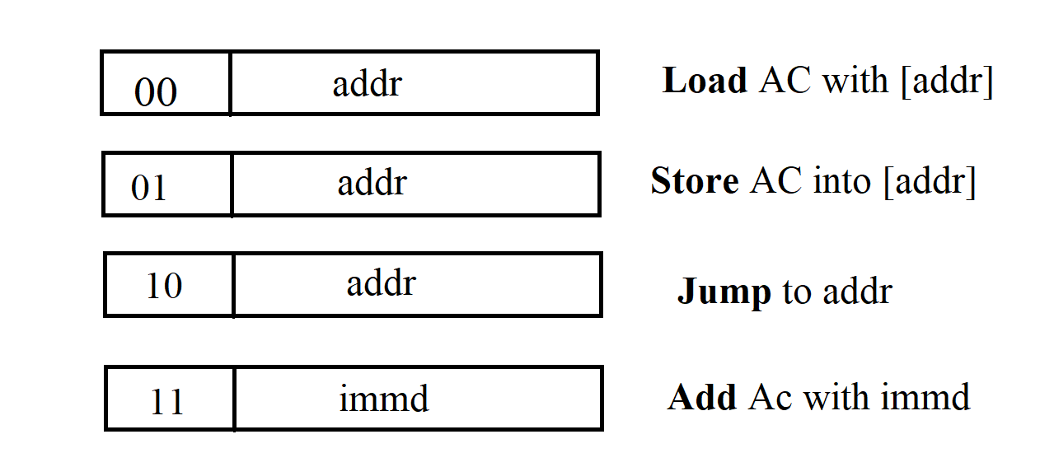
The general format of 8-bit instructions is shown below:
Adding CPU Instruction Format:
The OPCODE filed is a 2-bit code that specifies the type of instruction.
The Right most field specifies address or immediate data according to the instruction
The Immediate field is used for immediate data.
The 8-bit instructions have the Immediate field in case of add instruction.

Slide 8
Datapath Description:-
Processor has a total of 4 instructions as shown :
Our Adding CPU reads Load, Add, Store, and Jump instructions
The internal bus drivers d_bus connects to AC to bring data read from the memory into this register.
The control signal for loading AC is ld_ac. This control signal is issued when the Load
instruction is being expected.
PC has three control signals ld_pc, inc_pc and clr_pc to load, increment, and
clear it, respectively. The right most 6-bits of IR connect to the input of
PC for execution of the Jump instruction.
In Store instruction, AC is placed on the left input of ALU and from there
to dbus, which eventually goes on data_bus. At the same time, IR is placed
on addr_bus to specify the address in which AC data is to be stored.
For this purpose, the adder unit (ALU) has a pass control input to make
it pass its left input data to its output.
Add instruction is done by taking one of the add operands from AC and the
other from IR. For this instruction, activating the add control input of
ALU causes it to perform addition.

Slide 9
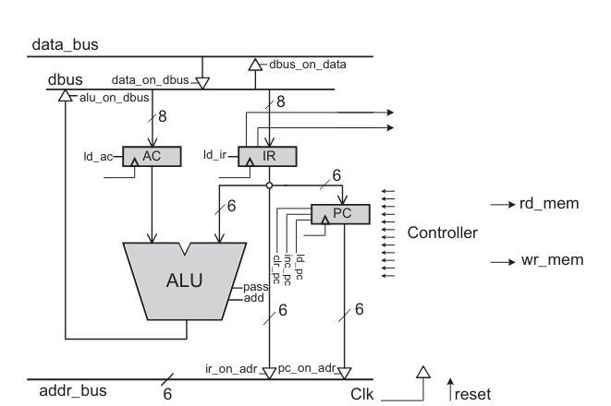
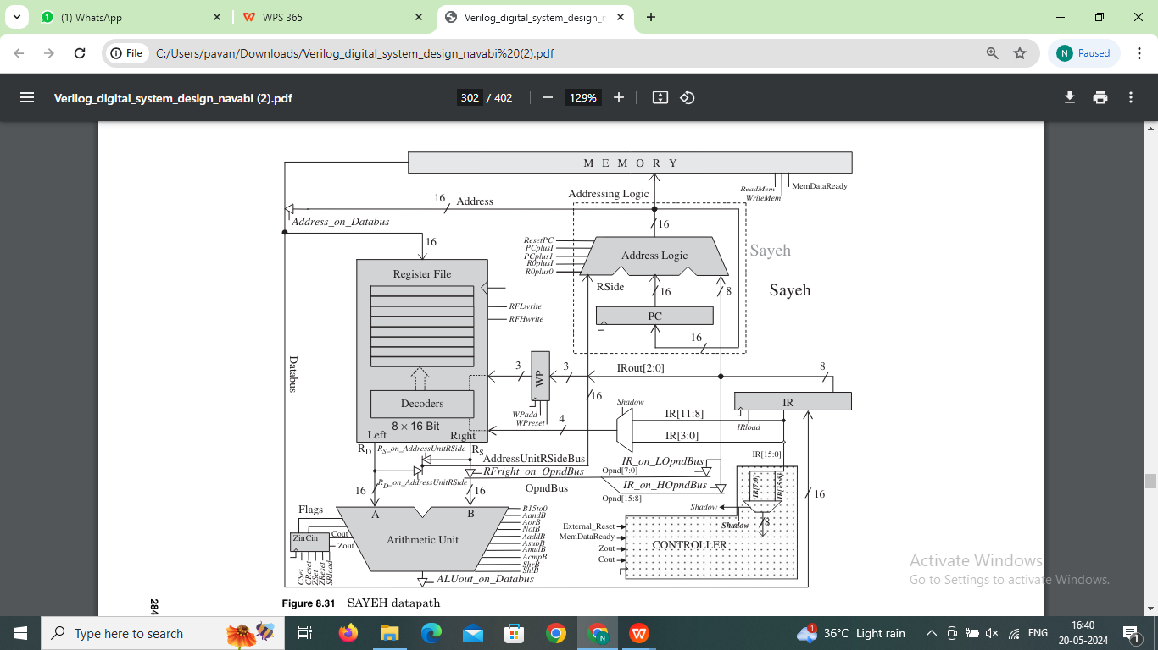
Datapath:
Architectural Design Of Adding CPU:

Slide 10
Datapath Components Verilog Code:
Codings presented for AC, IR, PC, and ALU are synthesizable and individually testable. These parts are instantiated in the datapath of our machine.
//accumulator verilog code
module AC ( input [7:0] data_in, input load, clk,
output reg [7:0] data_out );
always @( posedge clk )
if( load )
data_out <= data_in;
endmodule
//program counter verilog code
module PC ( input [5:0] data_in, input load, inc, clr, clk,
output reg [5:0] data_out );
always @( posedge clk)
if( clr ) data_out <= 6’b000_000;
else if( load ) data_out <= data_in;
else if( inc ) data_out <= data_out + 1;
endmodule

Slide 11
//instruction Register verilog code
module IR ( input [7:0] data_in, input load, clk,
output reg [7:0] data_out );
always @( posedge clk )
if ( load )
data_out <= data_in;
endmodule
//alu verilog code
module ALU ( input [7:0] a, b, input pass, add,
output reg[7:0] alu_out );
always @(a or b or pass or add)
if (pass) alu_out = a;
else if (add) alu_out = a + b;
else alu_out = 0;
endmodule

Slide 12
Datapath Verilog Code:
//datapath verilog code
module DataPath ( input ir_on_adr, pc_on_adr, dbus_on_data,data_on_dbus, ld_ir, ld_ac, ld_pc,
inc_pc, clr_pc, pass, add, alu_on_dbus,clk
output [5:0] adr_bus,
output [1:0] op_code,
inout [7:0] data_bus );
wire [7:0] dbus, ir_out, a_side, alu_out;
wire [5:0] pc_out;
IR ir ( dbus, ld_ir, clk, ir_out ); //instantiation of instruction register
PC pc ( ir_out[5:0], ld_pc, inc_pc, clr_pc, clk, pc_out );//instantiation of program counter
AC ac ( dbus, ld_ac, clk, a_side ); //instantiation of accumulator
ALU alu ( a_side, {2’b00,ir_out[5:0]}, pass, add, alu_out ); //instantiation of alu
assign adr_bus = ir_on_adr ? ir_out[5:0] : 6’bzz_zzzz;
assign adr_bus = pc_on_adr ? pc_out : 6’bzz_zzzz;
assign dbus = alu_on_dbus ? alu_out : 8’bzzzz_zzzz;
assign data_bus = dbus_on_data ? dbus : 8’bzzzz_zzzz;
assign dbus = data_on_dbus ? data_bus : 8’bzzzz_zzzz;
assign op_code = ir_out[7:6];
endmodule

Slide 13
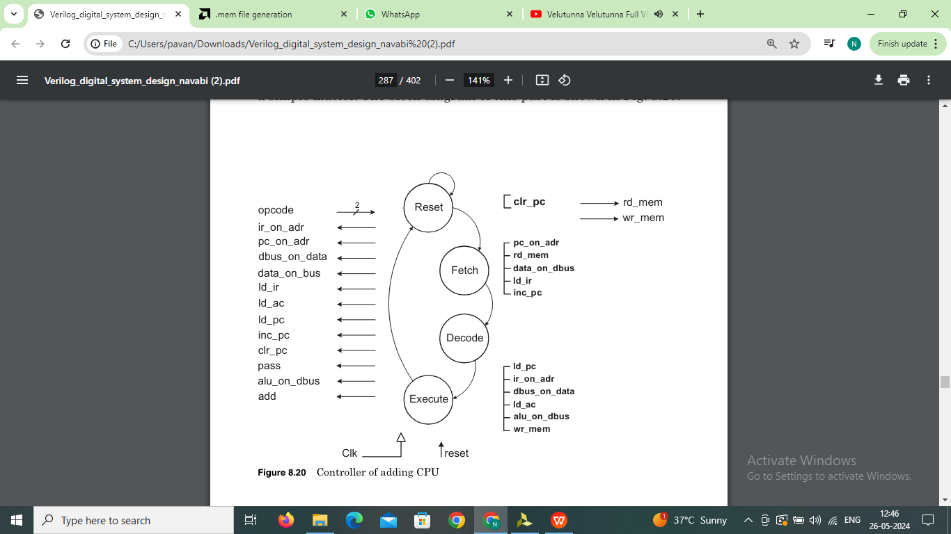
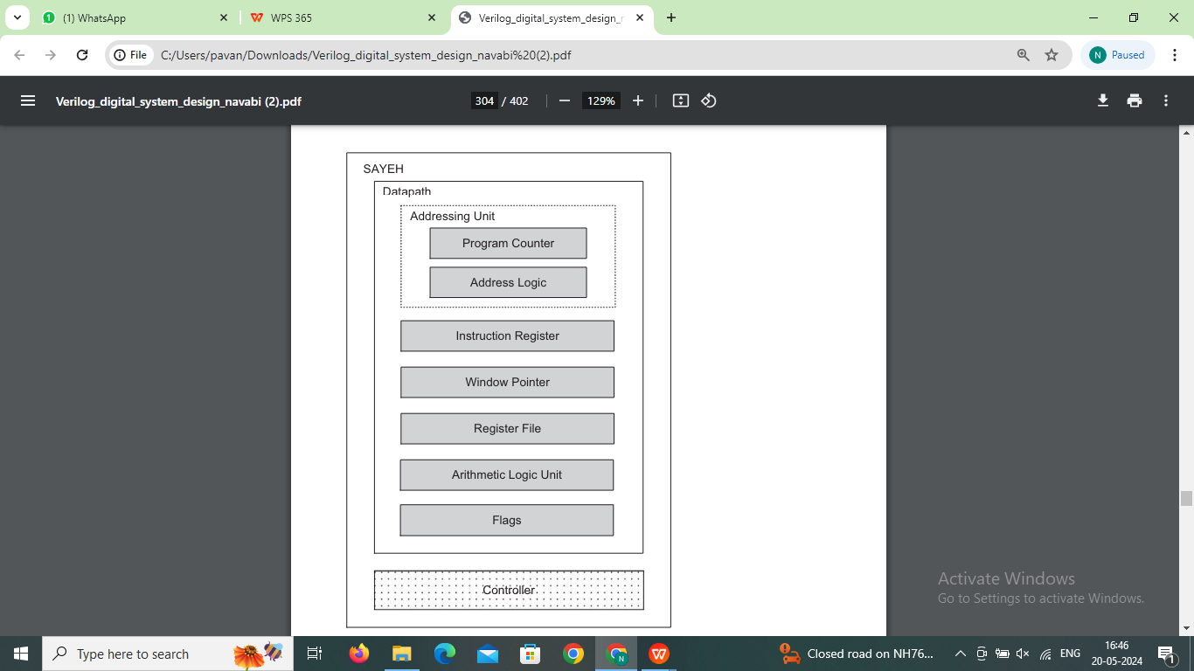





Control Path Design.
Controller Of Adding CPU:

Slide 14
Control unit Verilog code:
//controller verilog code
module Controller ( input reset, clk, input [1:0] op_code,
output reg rd_mem, wr_mem, ir_on_adr, pc_on_adr, dbus_on_data,
data_on_dbus, ld_ir, ld_ac, ld_pc, inc_pc,
clr_pc,pass, add, alu_on_dbus); parameter Reset=2'b00,Fetch=2'b01,Decode=2'b10,Execute=2'b11;
reg [1:0] present_state, next_state;
always @( posedge clk )
if( reset ) present_state <= Reset;
else present_state <= next_state;
always @( present_state or reset ) begin : Combinational
rd_mem=1’b0; wr_mem=1’b0; ir_on_adr=1’b0; pc_on_adr=1’b0;
dbus_on_data=1’b0; data_on_dbus=1’b0; ld_ir=1’b0;
ld_ac=1’b0; ld_pc=1’b0; inc_pc=1’b0; clr_pc=1’b0;
pass=0; add=0; alu_on_dbus=1’b0;
case ( present_state )
Reset : begin next_state = reset ? Reset : Fetch;
clr_pc = 1;
end // End Reset
Fetch : begin next_state = Decode;

Slide 15
//continue..
pc_on_adr = 1; rd_mem = 1; data_on_dbus = 1; ld_ir = 1; inc_pc = 1;
end // End Fetch
Decode : next_state = Execute; // End Decode
Execute: begin next_state = Fetch;
case( op_code )
2’b00: begin
ir_on_adr = 1; rd_mem = 1; data_on_dbus = 1; ld_ac = 1;
end
2’b01: begin
pass = 1;
ir_on_adr = 1; alu_on_dbus = 1;
dbus_on_data = 1; wr_mem = 1;
end
2’b10: ld_pc = 1;
2’b11: begin
add = 1; alu_on_dbus = 1; ld_ac = 1;
end
endcase
end//end excute
default : next_state = `Reset;
endcase
end
endmodule

Slide 16
Complete Adding CPU
//Complete Adding CPU Machine
module AddingCPU (input reset, clk,
output [5:0] adr_bus, output rd_mem, wr_mem,
inout [7:0] data_bus);
wire ir_on_adr, pc_on_adr, dbus_on_data, data_on_dbus,
ld_ir,
ld_ac, ld_pc, inc_pc, clr_pc, pass, add, alu_on_dbus;
wire [1:0] op_code;
Controller cu ( reset, clk, op_code, rd_mem, wr_mem, ir_on_adr,
pc_on_adr, dbus_on_data, data_on_dbus, ld_ir,
ld_ac, ld_pc, inc_pc, clr_pc, pass,
add, alu_on_dbus );
DataPath dp ( ir_on_adr, pc_on_adr, dbus_on_data, data_on_dbus,
ld_ir, ld_ac, ld_pc, inc_pc, clr_pc, pass, add,
alu_on_dbus, clk, adr_bus, op_code, data_bus );
endmodule

Slide 17
Test bench Outline:
For testing the Adding CPU we need a memory file to store instructions. So we created memory file mamed as “ instructions.mem ”. Each line in a .mem file represents a memory address and its corresponding data. The data can be in any format like binary, hexadecimal or decimal.
For testing the adding cpu we created the following instructions and stored them in hexadecimal format in instructions.mem file.
@0 20 ➔ Load 32 (i.e, load the data at 32nd location of mem in to AC)
@1 C4 ➔ Add 4 (i.e, add the immediate data with AC and store into AC)
@2 61 ➔Store 33 (i.e, Stores the AC data into 33rd location of mem)
@20 03 ➔ At the 32nd location of memory the data is 3.

Slide 18
Testbench:
//testbench verilog code
module testbench;
reg reset=1, clk=0;
wire [5:0] adr_bus;
wire rd_mem, wr_mem;
wire [7:0] data_bus;
reg [7:0] memory[0:64]; // Declare memory array
integer i;
initial begin
$readmemh("instructions.mem", memory); // Read the memory file into the array
#25 reset=1'b0;
end
addingcpu UUT(reset, clk, adr_bus, rd_mem, wr_mem, data_bus);
always #10 clk = ~clk;
reg [7:0] mem_data=8'b0;
reg control=0;
always@(posedge clk) begin : Memory_Read_Write
control = 1'b0;

Slide 19
#1;
if(rd_mem) begin
mem_data=memory[adr_bus];
control = 1'b1;
end
if(wr_mem) begin
#3 memory[adr_bus]=data_bus;
end
end
// Assigning( Copying) the mem_data to the data_bus
assign data_bus = (control) ? mem_data: 8'hZZ;
initial begin
// Display the memory content for verification
$display("Memory content:");
for (i = 0; i < 4; i = i + 1) begin
$display("Address %0d: %h", i, memory[i]);
end
end
endmodule

Slide 20
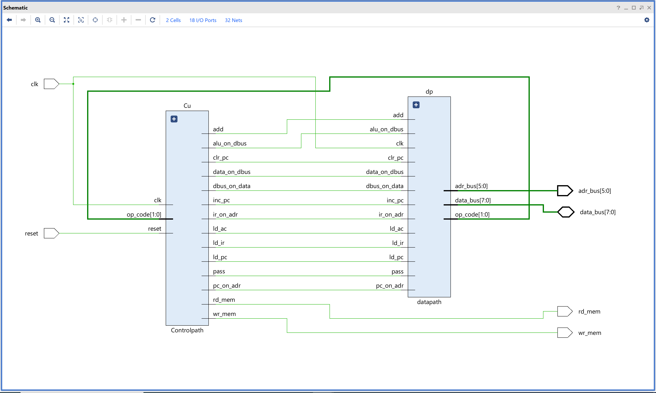
Adding CPU Schematic

Slide 21
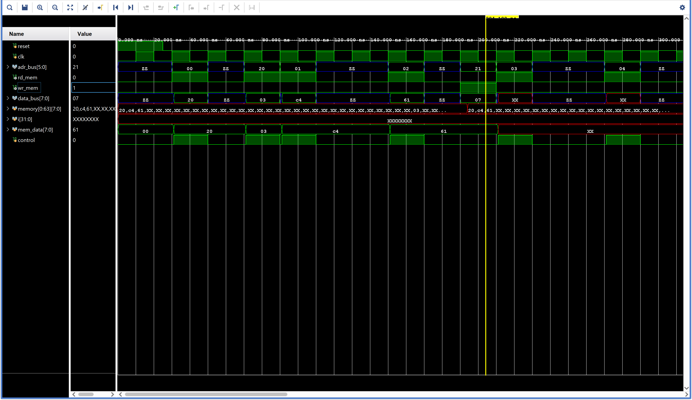
Results:

Slide 22



